Slide 1




The first rapid acting insulin biosimilar of NovoRapid® approved in the UK and EU¹
Trurapi is intended for HCPs practising in Great Britain (England, Scotland, Wales) only.
Similar PK/PD profile (T1DM), efficacy, safety and tolerability (T1DM and T2DM)²⁻³
1:1 initial unit dosing* - no initial dose conversion required* - available in the SoloStar pen, cartridges and vials¹⁻³
*When transferring from other insulin medicinal products, adjustment of the Trurapi® dose and the dose of the basal insulin may be necessary. Trurapi® has a faster onset and a shorter duration of action than soluble human insulin. Close glucose monitoring is recommended during the transfer and in the initial weeks thereafter. ¹
30% lower NHS list price vs. NovoRapid for prefilled Pens and Cartridges⁴
15% lower NHS list price vs. NovoRapid for Vials⁴
MAT-GB-2102821 V5.0 April 2023
This slide deck has been produced by Sanofi and is provided for personal reference by health professionals in Great Britain only.
Prescribing information and adverse event reporting can be found at the end of this presentation

Slide 2
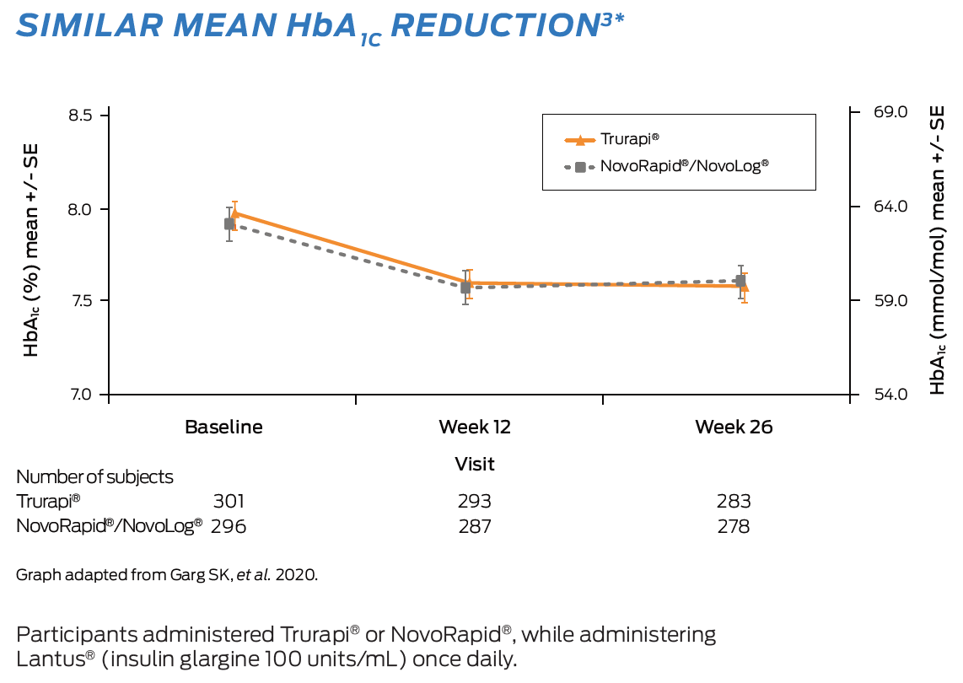
Similar mean HbA_{1C} reduction in adults with T1DM and T2DM^{3*}
At week 26, HbA_{1C} was -0.38% for Trurapi® group vs -0.30% for NovoRapid®/NovoLog® group.
Similar mean HbA1C reduction from baseline to Week 26 in Trurapi® and NovoRapid®/Novolog® groups were observed in patients with either T1DM or T2DM³
Non-inferior at 0.3% margin (primary endpoint)†

Slide 3
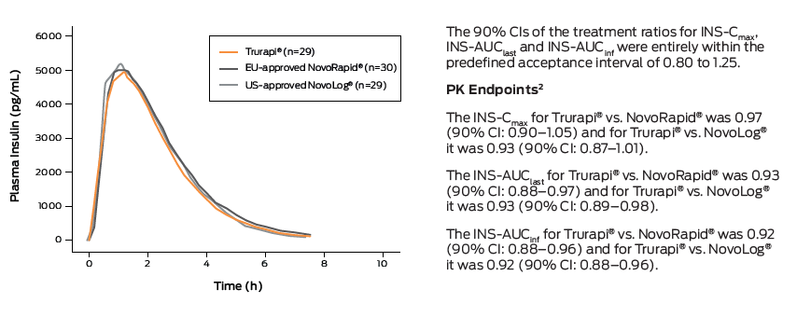
Similar PK/PD profile in adults with T1DM²
PK/PD profiles in the biosimilar Trurapi®, were similar to the UK and EU-approved NovoRapid® and US-approved Novolog® in patients with T1DM²
Pharmacokinetic profile²
Plasma insulin mean concentration vs. time profile

Slide 4
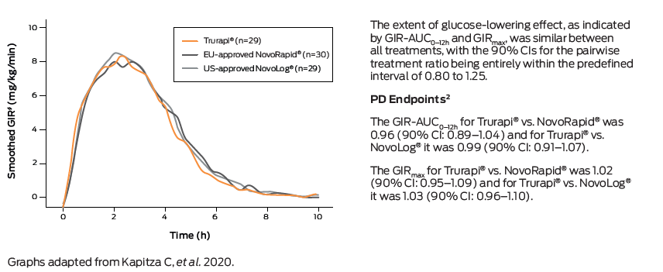
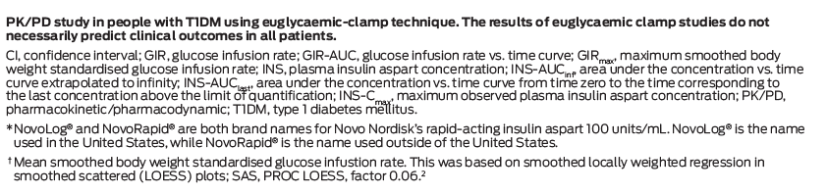
Pharmacodynamic profile^{2*}
Glucose infusion rate† vs. time curve

Slide 5
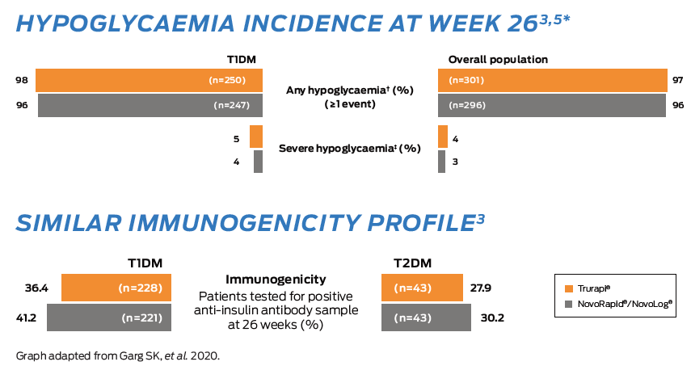
Similar long-term safety and tolerability profiles in adults with T1DM and T2DM^{3,5}
Similar incidence rates of any hypoglycaemic events (≥1 event) in both the T1DM and overall population were observed in both Trurapi® and NovoRapid®/Novolog® groups^{2,3}
Hypoglycaemia incidence at week 26^{3,5*}
Similar immunogenicity profile³

Slide 6
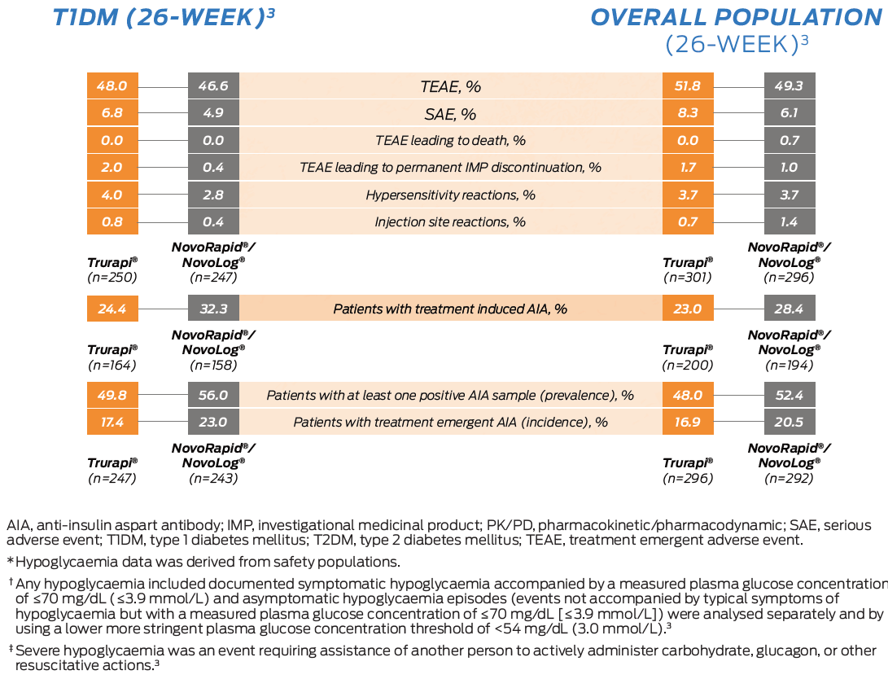
T1DM (26-week)³
Overall population (26-week)³

Slide 7
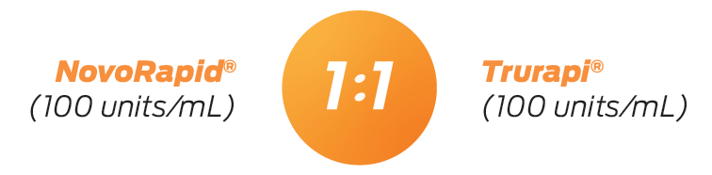
1:1 initial unit dosing* - available in the SoloStar pen, cartridges and vials¹⁻³
No initial dose conversion required* between aspart insulins
*When transferring from other insulin medicinal products, adjustment of the Trurapi® dose and the dose of the basal insulin may be necessary. Trurapi® has a faster onset and a shorter duration of action than soluble human insulin. Close glucose monitoring is recommended during the transfer and in the initial weeks thereafter. ¹

Slide 8
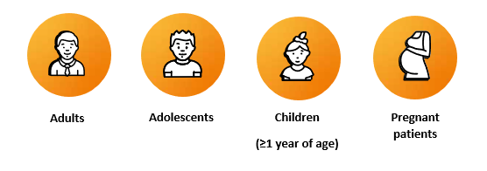
Available in SoloStar, a pen HCPs know and trust⁶
Also available in cartridges for use with Sanofi reusable pens and vials
Same therapeutic indication¹
Trurapi® is a rapid-acting insulin analog indicated for the treatment of diabetes mellitus in adults, adolescents and children aged 1 year and above¹

Slide 9

30% lower NHS list price vs. NovoRapid for prefilled Pens and Cartridges ⁴
15% lower NHS list price vs. NovoRapid for Vials ⁴
Presentation | Trurapi price | NovoRapid price | PIP Code
5 x 3 mL units/mL solution for injection in cartridge | 19.82 | 28.31 | 4180303
5 x 3 mL units/mL solution for injection in pre-filled pen | 21.42 | 30.60 | 4180386
1 x 10 mL units/mL solution for injection in vial | 11.97 | 14.08 | 4196804

Slide 10
References:
1. Trurapi® SmPC. April 2023.
2. Kapitza C, et al. Diabetes Technol Ther. 2020;22(4):278–284.
3. Garg SK, et al. Diabetes Technol Ther. 2020;22(2):85-95.
4. NHS DM+D: REF-161114. Available at: https://services.nhsbsa.nhs.uk/dmd-browser/.
Date accessed: April 2023. 5. Garg SK, et al. Diabetes Technol Ther. 2020;22(2):85–95. (Supplementary Figure S4).
6. Data on File - IQVIA Worldwide Disposable Insulin Pen Usage in 2020, MAT-GB-2101762(v1.0)
MAT-GB-2102821 V5.0 April 2023
This slide deck has been produced by Sanofi and is provided for personal reference by health professionals in Great Britain only.
Prescribing information and adverse event reporting can be found at the end of this presentation

Slide 11
Prescribing Information: Trurapi (Insulin aspart 100 units/ml)
Please refer to the Summary of Product Characteristics (SmPC) before prescribing.
Presentation: Trurapi 100 units/ml (equivalent to 3.5 mg) solution for injection in a vial, each containing 10ml of solution for injection, equivalent to 1000 units. Trurapi 100 units/ml solution for injection in a cartridge or in a pre-filled pen, each containing 3ml of solution for injection, equivalent to 300 units insulin aspart.
Indication: The treatment of diabetes mellitus in adults, adolescents and children aged 1 year and above.
Dosage and Administration: Trurapi is a rapid-acting insulin analogue, normally used in combination with intermediate-acting or long-acting insulin. Trurapi should not be mixed with any other insulin. The dosage should be determined by the physician in accordance with individual patient needs. Blood glucose monitoring and insulin dose adjustments are recommended to achieve optimal glycaemic control. The individual insulin requirement in adults and children is usually 0.5–1.0 unit/kg/day. In a basal-bolus treatment regimen 50–70% of this requirement may be provided by Trurapi and the remainder by intermediate-acting or long-acting insulin. Adjustment of dose may be necessary if patients undertake increased physical activity, change their usual diet or during concomitant illness (see Precautions and Warnings). Transfer from other insulin medicinal products: When transferring from other insulin medicinal products, adjustment of the Trurapi and basal insulin dose may be necessary as Trurapi has a faster onset and a shorter duration of action than soluble human insulin. When injected subcutaneously into the abdominal wall, the onset of action will occur within 10–20 minutes of injection. The maximum effect is exerted 1–3 hours after the injection with duration of action of 3–5 hours. Subcutaneous administration: This should be in the upper arms, thighs, buttocks or abdomen and injection sites should always be rotated within the same region in order to reduce the risk of lipodystrophy and cutaneous amyloidosis. Subcutaneous injection in the abdominal wall ensures a faster absorption than other injection sites and faster onset of action of insulin aspart is maintained regardless of the injection site. The duration of action will vary according to the dose, injection site, blood flow, temperature and level of physical activity. Due to the faster onset of action, insulin aspart should generally be given immediately before a meal. When necessary insulin aspart can be given soon after a meal. Trurapi in cartridges: only suitable for subcutaneous injections from a specified type of reusable pen. Trurapi in pre-filled pen: only suitable for subcutaneous injections. Trurapi in pre-filled pen delivers 1-80 units in increments of 1 unit. Patients must visually verify the dialled units on the dose counter of the pen. Therefore, the requirement for patients to self-inject is that they can read the dose counter on the pen. Patients who are blind or have poor vision must be instructed to always get help/assistance from another person who has good vision and is trained in using the insulin device. Administration via an insulin infusion pump (Trurapi vials only): CSII should be administered in the abdominal wall and infusion sites should be rotated. Patients using CSII should be comprehensively instructed in the use of the pump system and use the correct reservoir and tubing for the pump. The infusion set (tubing and cannula) should be changed in accordance with the instructions in the product information supplied with the infusion set. An alternative insulin delivery method should be available in case of pump system failure. Intravenous administration (Trurapi vials only): This should be carried out by physicians or other healthcare staff following normal clinical practice for intravenous injections. Monitoring of blood glucose is necessary during insulin infusion.
Special Populations: Elderly patients (≥ 65 years old) and renal/hepatic impairment: Trurapi can be used in elderly patients and patients with renal or hepatic impariment; glucose monitoring should be intensified and dose adjusted on an individual basis. Paediatric population: Trurapi can be used in adolescents and children aged 1 year and above in preference to soluble human insulin when a rapid onset of action might be beneficial, for example, in the timing of the injections in relation to meals. The safety and efficacy in children below 1 year of age have not been established.
Contraindications: Hypersensitivity to insulin aspart or to any of the excipients.
Precautions and Warnings: Traceability: The name and the batch number of the administered product should be
clearly recorded to improve the traceability. Injection technique: Patients must be instructed to perform continuous rotation of the injection site to reduce the risk of developing lipodystrophy and cutaneous amyloidosis. There is a potential risk of delayed insulin absorption and worsened glycaemic control following insulin injections at sites with these reactions. A sudden change in the injection
site to an unaffected area has been reported to result in hypoglycaemia. Blood glucose monitoring is recommended
after the change in the injection site, and dose adjustment of antidiabetic medicinal products may be considered. Hyperglycaemia: Inadequate dosing or discontinuation of treatment, especially in type 1 diabetes, may lead to hyperglycaemia and diabetic ketoacidosis. Usually the first symptoms of hyperglycaemia develop gradually over a period of hours or days. They include thirst, increased frequency of urination, nausea, vomiting, drowsiness, flushed dry skin, dry mouth, loss of appetite as well as acetone odour of breath. In type 1 diabetes, untreated hyperglycaemic events eventually lead to diabetic ketoacidosis which is potentially lethal. Hypoglycaemia: Omission of a meal or unplanned, strenuous physical exercise may lead to hypoglycaemia. Especially in children, care should be taken to match insulin doses (especially in basal-bolus regimens) with food intake, physical activities and current blood glucose level in order to minimise the risk of hypoglycaemia. Hypoglycaemia may occur if the insulin dose is too high in relation to the insulin requirement and in case of hypoglycaemia or if hypoglycaemia is suspected insulin aspart must not be injected. After stabilisation of patient’s blood glucose adjustment of the dose should be considered. Patients whose blood glucose control is greatly improved may experience a change in their usual warning symptoms of hypoglycaemia, and usual warning symptoms may disappear in patients with longstanding
diabetes, so patients should be advised accordingly. Hypoglycaemia in rapid-acting insulin analogues may occur earlier after an injection when compared with soluble human insulin and since insulin aspart should be administered immediately in relation to a meal, the rapid onset should be considered in patients with concomitant diseases or treatment where a delayed absorption of food might be expected. Concomitant illness usually increases the patient’s insulin requirements and concomitant diseases in the kidney, liver or affecting the adrenal, pituitary or thyroid gland carequire changes in the insulin dose. When patients are transferred between different types of insulin medicinal products, the early warning symptoms of hypoglycaemia may change or become less pronounced than those experienced with their previous insulin. Transfer from other insulin medicinal products: Should be done under strict medical supervision. If dose adjustment is needed, it may occur with the first dose or during the first few weeks or months. Close glucose monitoring is recommended during the transfer andin the initial weeks thereafter. Injection site reactions (including lipodystrophy and cutaneous amyloidosis): As with any insulin therapy, injection site reactions may occur and include pain, redness, hives, inflammation, bruising, swelling and itching. Continuous rotation of the injection
site within a given area reduces the risk of developing these reactions and these usually resolve in a few days to a few weeks. Continuous rotation of the injection site also reduces the risk of developing lipodystrophy and cutaneous amyloidosis. Blood glucose monitoring is recommended after the change in the injection site due to risk of hypoglycaemia, and dose adjustment of antidiabetic medications may be considered. On rare occasions, injection site reactions may require discontinuation of insulin aspart. Combination with pioglitazone: Cases of
cardiac failure have been reported when pioglitazone was used in combination with insulin, especially in patients with risk factors for development of cardiac heart failure. Pioglitazone should be discontinued if any deterioration in cardiac symptoms occurs. Medication errors: Patients must be instructed to always check the insulin label before each injection to avoid accidental mix-ups between Trurapi and other insulin medicinal products. Insulin antibodies: Insulin administration may cause insulin antibodies to form, which in rare cases may necessitate adjustment of the insulin dose to correct a tendency to hyper- or hypoglycaemia. Travel: Patients should seek physician advice before travelling to different time zones as this may mean that the insulin and meals may be taken at different times. Sodium:This medicinal product contains less than 1 mmol sodium (23mg) per dose, that is to say essentially “sodium free”. Interactions: Several medicinal products are known to interact with the glucose metabolism. Substances that may reduce insulin requirements: Oral antidiabetic medicinal products, monoamine oxidase inhibitors (MAOI), betablockers, angiotensin converting enzyme (ACE) inhibitors, salicylates, anabolic steroids and sulphonamides. Substances that may increase insulin requirements: Oral contraceptives, thiazides, glucocorticoids, thyroid hormones, sympathomimetics, growth hormone and danazol. Other potential interactions of note: Octreotide/lanreotide may either increase or decrease the insulin requirement. Beta-blockers may mask the symptoms of hypoglycaemia. Alcohol may intensify or reduce the hypoglycaemic effect of insulin.
Pregnancy and Breast-Feeding: Pregnancy: It is essential to maintain good control of the insulin-treated (insulindependent or gestational diabetes) patient throughout pregnancy and intensified blood glucose control and monitoring of pregnant women with diabetes are recommended throughout pregnancy and when contemplating pregnancy. Data from two randomised controlled clinical trials do not indicate any adverse reaction of insulin aspart on pregnancy or on the health of the fetus/newborn when compared to human insulin. Breastfeeding: There are no restrictions on treatment with Trurapi during breast-feeding, but the dose may need to be adjusted.
Adverse Reactions: Adverse reactions observed in patients using Trurapi are mainly due to the pharmacologic effect of insulin. Hypoglycaemia is the most frequent adverse reaction and may occur if the insulin dose is too high in relation to the insulin requirement. Uncommon (≥1/1,000 to <1/100): urticaria, rash, eruptions, refraction disorders, diabetic retinopathy, injection site reactions such as
lipodystrophy and oedema that can be reduced by continuous rotation of the injection site. Rare (≥1/10,000 to <1/1,000): Peripheral neuropathy (painful neuropathy). Very rare (<1/10,000): anaphylactic reactions which can potentially be life threatening. Frequency not known: cutaneous amyloidosis. Special populations: The frequency, type and severity of adverse reactions observed in the paediatric population, elderly patients and patients with renal or hepatic impairment do not indicate any differences to the broader experience in the general population. Prescribers should consult the SPC in relation to other adverse reactions.
Legal Category: POM Marketing Authorisation (MA) Holder: Sanofi, 410 Thames Valley Park Drive, Reading, Berkshire, RG6 1PT,UK.
GB List price and MA numbers: Trurapi 100 units/ml solution for injection in vial 1 x 10ml: £11.97 – PLGB 04425/0891. Trurapi 100 units/ml solution for injection in cartridge 5 x 3ml: £19.82 – PLGB 04425/0885. Trurapi 100 units/ml solution for injection in pre-filled pen 5 x 3ml: £21.42 – PLGB 04425/0886.
Further information is available from: Medical Information, Sanofi, 410 Thames Valley Park Drive, Reading, Berkshire, RG6 1PT, UK. UK-medicalinformation@sanofi.com. SmPC Date: 29/03/2023
Date of preparation: April 2023. Document Number: MAT-XU-2301609 (v1.0)
Adverse events should be reported. Reporting forms and information can be found at www.mhra.gov.uk/yellowcard or search for
MHRA Yellow Card in the Google Play or Apple App Store.
Adverse events should also be reported to Sanofi Tel: 0800 090 2314. Alternatively, send via email to UK-drugsafety@sanofi.com

Slide 12
Prescribing Information: Lantus® (insulin glargine) 100 units/ml solution for injection
Please refer to Summary of Product Characteristics (SmPC) before prescribing.
Presentations: Lantus 100 units/ml solution for injection in a vial or in a cartridge. Lantus SoloStar 100 units/ml solution for injection in a pre-filled pen. Lantus cartridges and Solostar pre- filled pens each contain 3 ml of solution for injection, equivalent to 300 units insulin glargine. Each vial contains 10 ml of solution for injection, equivalent to 1000 units.
Indications: Treatment of diabetes mellitus in adults, adolescents and children of 2 years or above.
Dosage and administration: Lantus is administered subcutaneously once daily, at any time but at the same time each day. Injection sites must be rotated within a given injection area from one injection to the next in order to reduce the risk of lipodystrophy and cutaneous amyloidosis. Do not administer intravenously. Lantus dosage should be individually adjusted. In type 2 diabetes mellitus, Lantus can also be used in combination with orally active antidiabetic medicinal products. Lantus must not be mixed with other insulins or diluted. Switch from twice daily NPH insulin to Lantus: To reduce the risk of nocturnal and early morning hypoglycaemia, patients who are changing their basal insulin regimen from a twice daily NPH insulin to a once daily regimen with Lantus should reduce their daily dose of basal insulin by 20 – 30% during the first weeks of treatment. Switch from Toujeo (insulin glargine) 300 units/ml to Lantus: Lantus and Toujeo are not bioequivalent and are not directly interchangeable. To reduce the risk of hypoglycemia, patients who are changing their basal insulin regimen from an insulin regimen with once daily Toujeo to a once daily regimen with Lantus should reduce their dose by approximately 20%. Switching from other insulins to Lantus: When switching from a treatment regimen with an intermediate or long-acting insulin to a regimen with Lantus, a change of the dose of the basal insulin may be required and the concomitant antidiabetic treatment may need to be adjusted (dose and timing of additional regular insulins or fast-acting insulin analogues or the dose of oral antidiabetic medicinal products). Close metabolic monitoring is recommended during, and for a period after, transition from other insulins to Lantus. Dose adjustments may also be required if the patient’s weight or lifestyle changes, the timing of insulin dose is changed or other circumstances arise that increase susceptibility to hypo- or hyperglycaemia.
Special populations: Elderly, renal or hepatic impairment: Insulin requirements may be diminished. Paediatric population (<2 years of age): No data are available.
Contraindications: Hypersensitivity to insulin glargine or any excipients.
Precautions and warnings: Lantus is not the insulin of choice for treatment of diabetic ketoacidosis. In case of insufficient glucose control or a tendency to hypo/hyperglycaemic episodes all relevant factors must be reviewed before dose adjustment is considered. Transferring a patient to another type or brand of insulin should be done under strict medical supervision. Traceability: In order to improve the traceability of biological medicinal products, the name and the batch number of the administered product should be clearly recorded. Injection technique: Patients must be instructed to perform continuous rotation of the injection site to reduce the risk of developing lipodystrophy and cutaneous amyloidosis. There is a potential risk of delayed insulin absorption and worsened glycaemic control following insulin injections at sites with these reactions. A sudden change in the injection site to an unaffected area has been reported to result in hypoglycaemia. Blood glucose monitoring is recommended after the change in the injection site, and dose adjustment of antidiabetic medications may be considered. Intercurrent illness also requires intensified metabolic monitoring. Hypoglycaemia: Particular caution should be exercised, and intensified blood monitoring is advisable for patients in whom hypoglycaemic episodes might be of clinical relevance and in those where dose adjustments may be required. Warning signs of hypoglycaemia may be changed, less pronounced or absent in certain risk groups. The prolonged effect of subcutaneous Lantus may delay recovery from hypoglycaemia. Due to more sustained basal insulin supply with Lantus, less nocturnal but earlier morning hypoglycaemia can be expected. Insulin antibodies: administration may cause insulin antibodies to form. Rarely, this may necessitate dose adjustment. Pioglitazone: Cases of cardiac failure have been reported, especially in patients with risk factors for development of cardiac heart failure. Patients on this combination should be observed and pioglitazone should be discontinued if any deterioration in cardiac symptoms occurs. Medication errors: Insulin labels must always be checked before each injection to avoid errors between Lantus and other insulins. Lantus Solostar is only suitable for subcutaneous injections from its pre-filled pen. Lantus cartridges are only suitable for subcutaneous injections from specific reusable pens (please refer to SmPC for further details). If administration by syringe is necessary, a vial should be used. Interactions: A number of substances affect glucose metabolism and may require dose adjustment of Lantus. Pregnancy and lactation: No clinical data on exposed pregnancies from controlled clinical trials are available. A large amount of post-marketing data indicates no specific adverse effects of Lantus in pregnancy. Use of Lantus in pregnancy can be considered if clinically needed. Insulin requirements may decrease during the first trimester and generally increase during the second and third trimesters. Immediately after delivery, insulin requirements decline rapidly (increased risk of hypoglycaemia). Careful monitoring of glucose control is essential. It is unknown if Lantus is excreted in breast milk.
Adverse reactions: Very common: Hypoglycaemia. Prolonged or severe hypoglycaemia may be life-threatening. Overdose may lead to severe and sometimes long-term and life-threatening hypoglycaemia. Common: Lipohypertrophy, injection site reactions. Uncommon: Lipoatrophy. Rare: Allergic reactions, visual impairment, retinopathy and oedema. Very rare: Dysgeusia, myalgia. Frequency not known: Cutaneous amyloidosis. Prescribers should consult the SmPC in relation to other adverse reactions.
Legal category: POM.
GB list price and Marketing Authorisation Number(s): 1 x 10ml Lantus vial (PLGB 04425/0814): £25.69; 5 x 3ml Lantus cartridge (PLGB 04425/0815): £34.75; 5 x 3ml Lantus SoloStar (PLGB 04425/0816): £34.75.
Marketing Authorisation Holder: Sanofi, 410 Thames Valley Park Drive, Reading, Berkshire, RG6 1PT, UK.
For more information please contact: Medical Information, Sanofi, 410 Thames Valley Park Drive, Reading, Berkshire, RG6 1PT, UK. uk-medicalinformation@sanofi.com.
Date of preparation: October 2022. MAT-XU-2204110 (V1.0)
Adverse events should be reported. Reporting forms and information can be found at www.mhra.gov.uk/yellowcard or search for MHRA Yellow Card in the Google Play or Apple App Store.
Adverse events should also be reported to Sanofi Tel: 0800 090 2314. Alternatively, send via email to uk-drugsafety@sanofi.com

